Slide 1
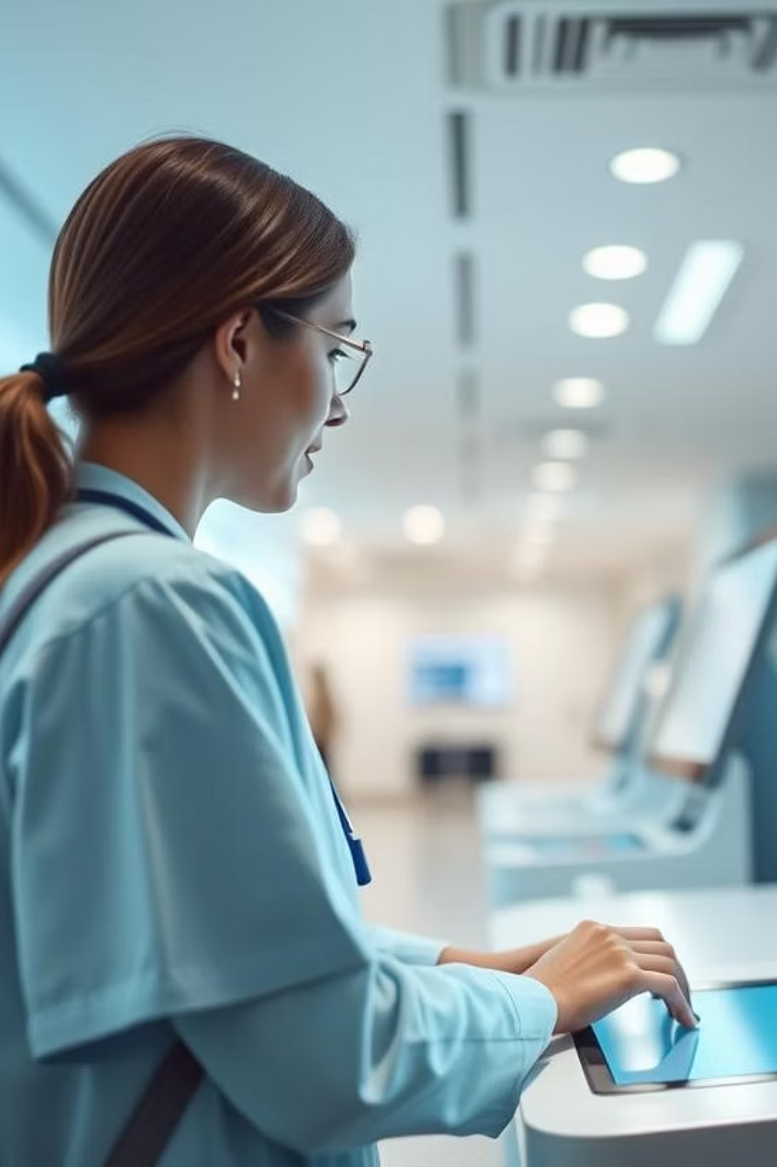
Problem Statement & Our Proposal
Problem Statement:
"Can technologies like Face ID recognition be brought in with advanced authorization from the patient, as seen in Digi Yatri Kiosks, to fasten the registration and check-in process?"
Current hospital check-in systems are either manual (slow, error-prone) or biometric (expensive, complex, and privacy-sensitive). Face recognition introduces:
High hardware costs
Data privacy challenges
Vulnerability to deepfakes and spoofing

Slide 2
Our Proposal
A QR-based, AES-encrypted mobile authentication system that allows patients to securely check in at kiosks using their mobile app—without facial recognition or biometric data.
Cost-effective
Privacy-first
no expensive biometric hardware
no facial data is stored or transmitted
Secure
Scalable & lightweight
dynamic, one-time QR codes with AES-256 encryption
ideal for Tier 2/3 cities
Facial recognition may work in some contexts, but we offer a more practical, scalable solution for healthcare in India.

Slide 3




Why This Problem Matters Today
Overburdened Hospital Front Desks
Cost & Maintenance of Face Recognition
Average wait times have increased 20–30% over a decade 😟 Reduces satisfaction and throughput
Kiosks cost $2,000–$5,000 each 🔧 Require AI processors, cameras, and calibration
Data Privacy & Ethical Concerns
Scalability Issues in Tier 2/3 Cities
Deepfake risk + identity spoofing 🔓 Biometric leaks are irreversible
Small clinics can't afford biometrics 📲 Need simple, mobile-first tech

Slide 4

Our Feature – How It Works
System Overview
Core Features
App login via 4-digit PIN
AES 256-bit encryption
Kiosk generates AES-encrypted dynamic QR
One-time-use QR codes
App scans and decrypts the QR
No biometric data
Sends credentials securely to kiosk
Works on any Android/iOS phone
Instant check-in—no face, ID, or card needed

Slide 5
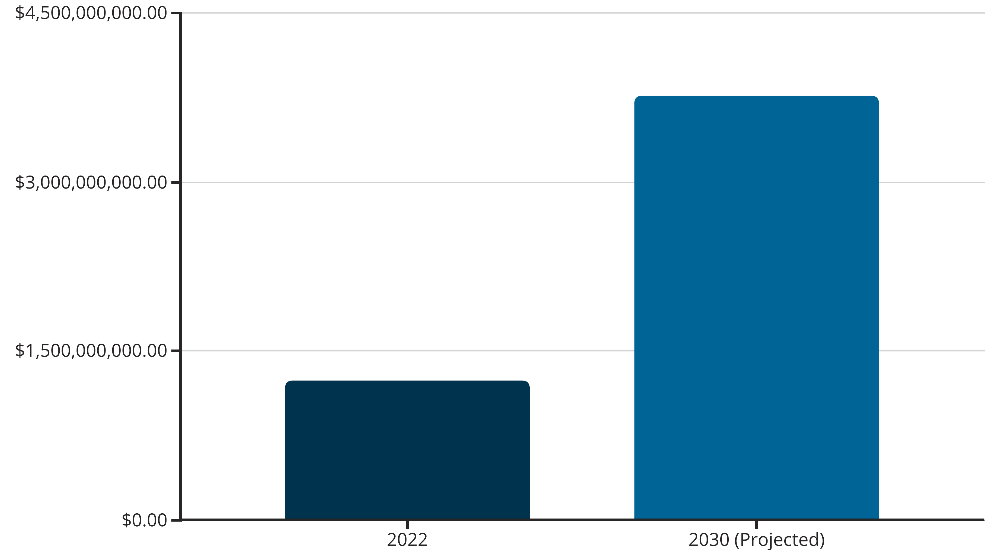
Market Analysis
Global Healthcare Kiosk Market
CAGR: 14.8% (Source: Grand View Research, MarketWatch)
Global Healthcare Kiosk Market
2022: $1.24 Billion
2030 (Projected): $3.76 Billion
Why There’s Scope
Growing hospital automation demand
QR familiarity from UPI, Digi Yatra
Legal pressure reducing face-ID rollout (DPDP Act, GDPR)

Slide 6





Why This Will Be Accepted
Familiar User Behavior
Security
Low Cost & Maintenance
QR is already used for payments, boarding, vaccine apps. No learning curve—fast onboarding.
AES-256 encrypted, session-based codes. Immune to deepfakes and spoofing.
No cameras, sensors, or biometrics needed. Runs on standard hardware.
Highly Scalable
ERP-Friendly
Deployable in small clinics and rural health centers.
Easily integrates with hospital systems (EHR, ABHA, etc.)

Slide 7
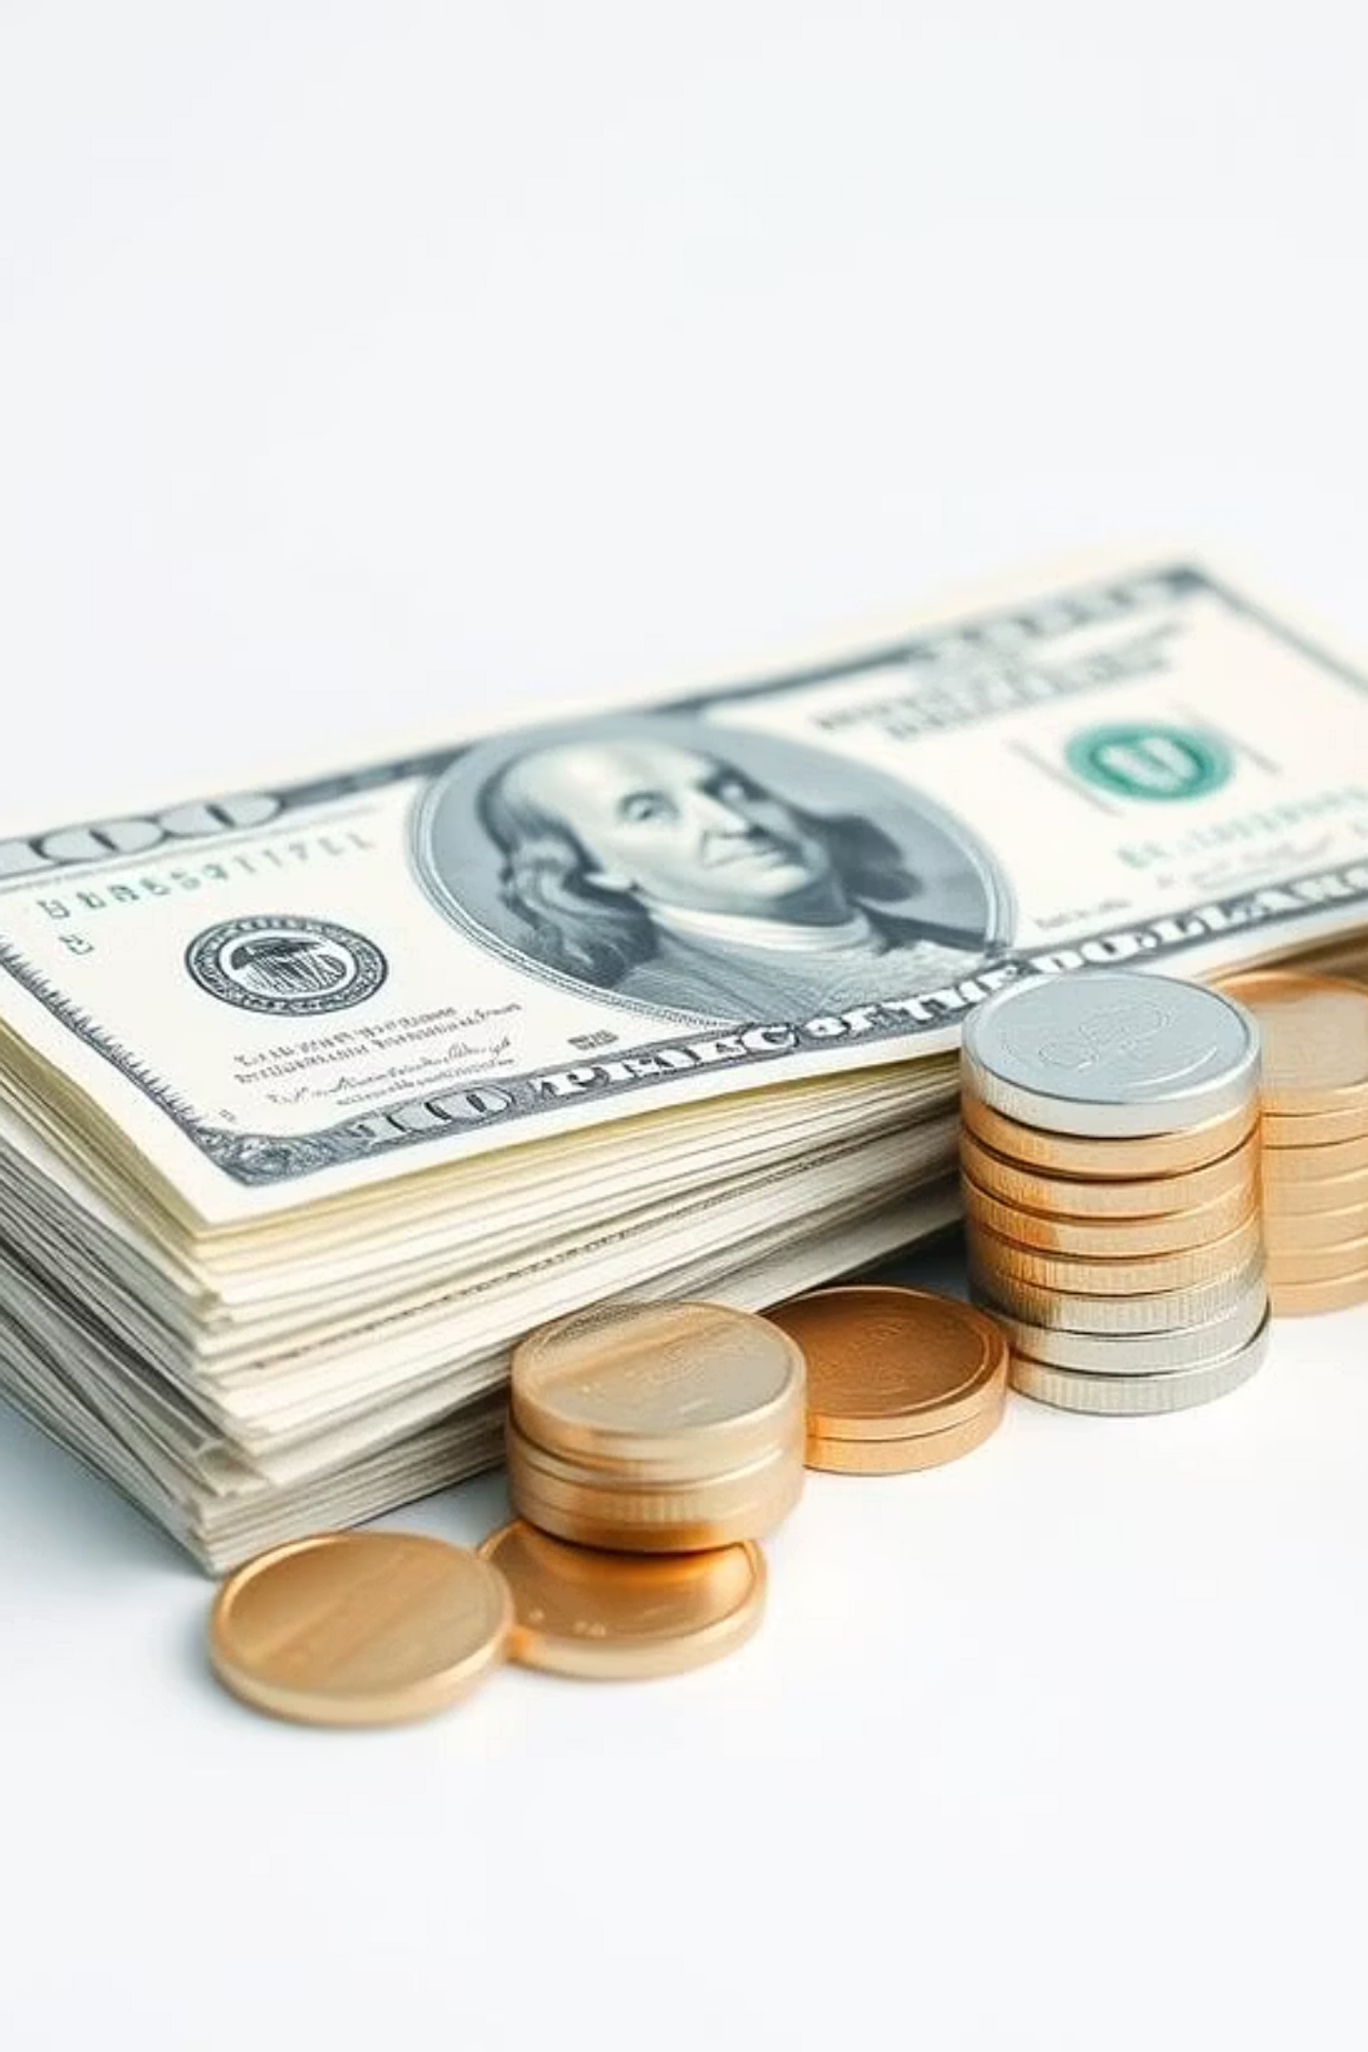
Revenue Opportunity & Profits
Current Kiosk Industry (Intel, others):
Our Model:
License: $1,000/year per kiosk
~$20,000 per kiosk (hardware + software)
Add-ons: $200/year (OTA updates, key mgmt)
Maintenance: 20% annually
Hundreds sold per year
Projection – 500 Hospitals
Core revenue: $500,000/year
Add-ons: $100,000/year
Total: $600,000/year
💰 Profit Margin: 20–30%
Break-even in 18–24 months

Slide 8
Unique Value Proposition (UVP)
Top-grade Security
Zero Biometric Hardware
Low Maintenance
AES 256-bit encryption
no face capture, no cameras
fewer moving parts
Familiar UX
Plug-and-Play
scans like UPI/Digi Yatra
ERP, NDHM, and ABHA integration ready

Slide 9
Key Partnerships
To Make It Happen
Kiosk OEMs
1
Olea, Advantech, Bharat Electronics
Hospital IT Vendors
2
Cerner, Epic, Indian EHRs
Govt. Health Stack
3
NDHM, ABHA APIs
Security Providers
4
AWS KMS, Thales, CloudHSM
System Integrators
5
Wipro, TCS, Tech Mahindra

Slide 10
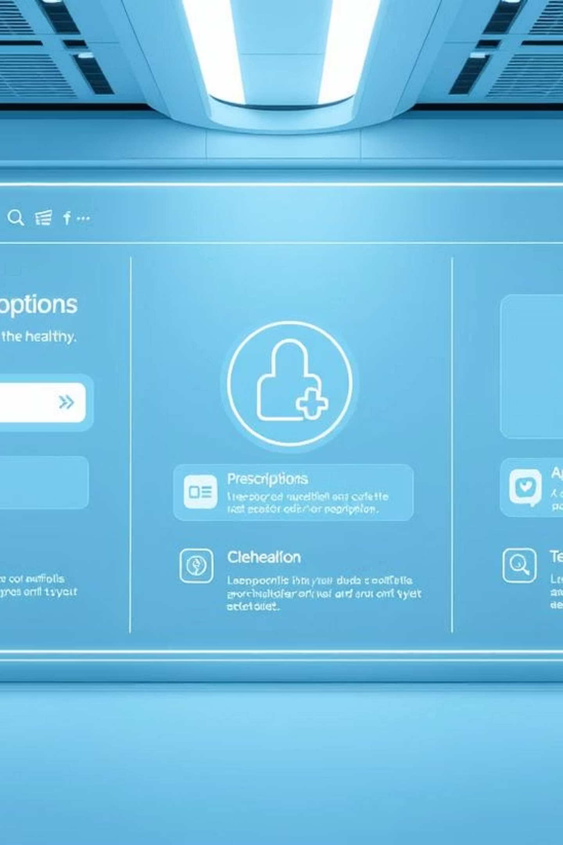
What Else We Can Bring to the Table
Future Features
Appointment booking
E-prescription storage
Telehealth room QR check-in
Admin dashboards
Over-the-air software updates
Vision
A single mobile interface for hospital, telehealth, and pharmacy systems — a digital front door to healthcare.

Slide 11

Roadmap
Phase 1 (1–2 months): Prototype + internal testing
Phase 2 (3–5 months): Beta launch in 3–5 hospitals
Phase 3 (6–12 months): Commercial rollout
Phase 4 (Year 2): Scale to 100+ hospitals
Phase 5: Integrate with insurance, telemedicine

Slide 12
Conclusion
Our solution replaces costly, high-maintenance face recognition with a secure, familiar, and scalable QR-based authentication system—built for India’s evolving healthcare ecosystem.
Let’s build hospital check-ins that are:
Secure
Familiar
Intelligent
Affordable

